Slide 1



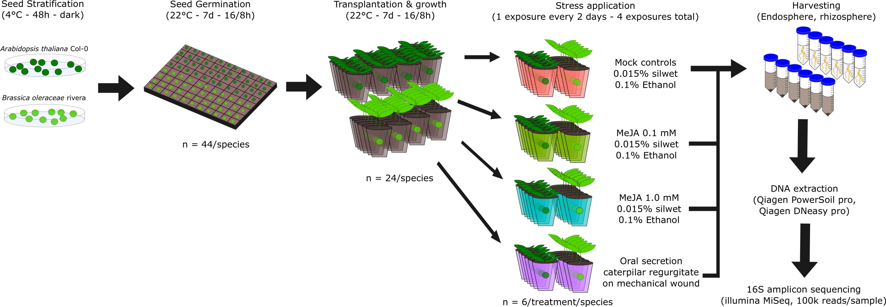
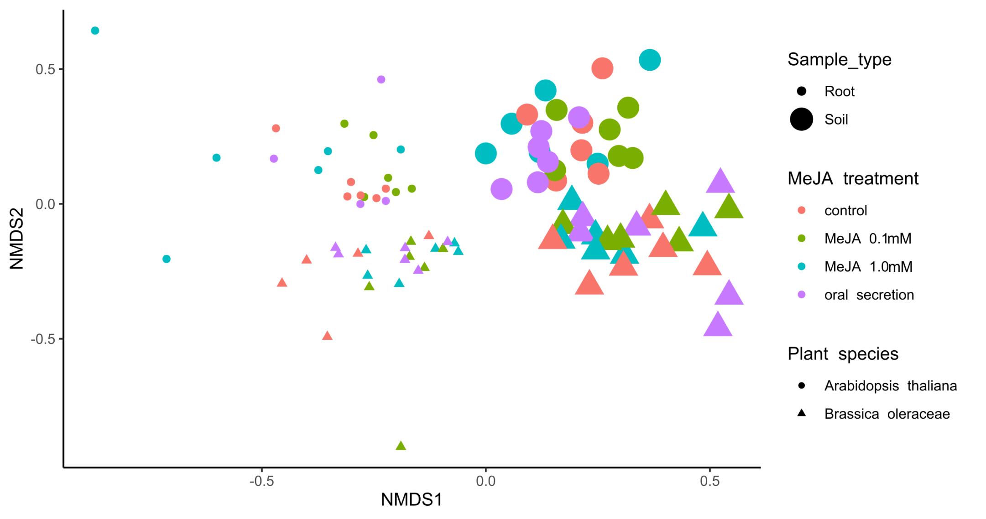
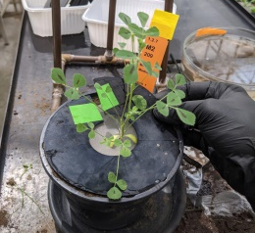
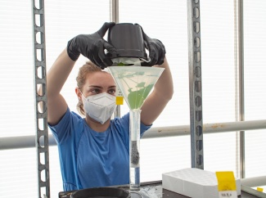
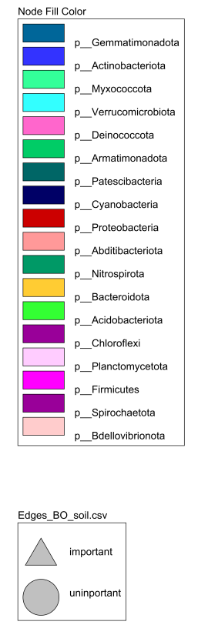
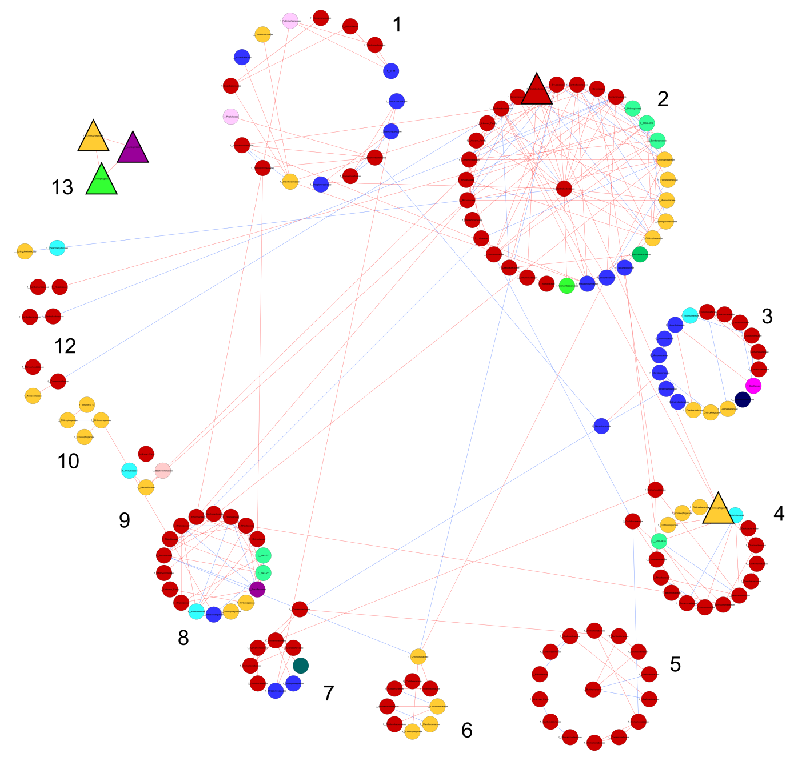
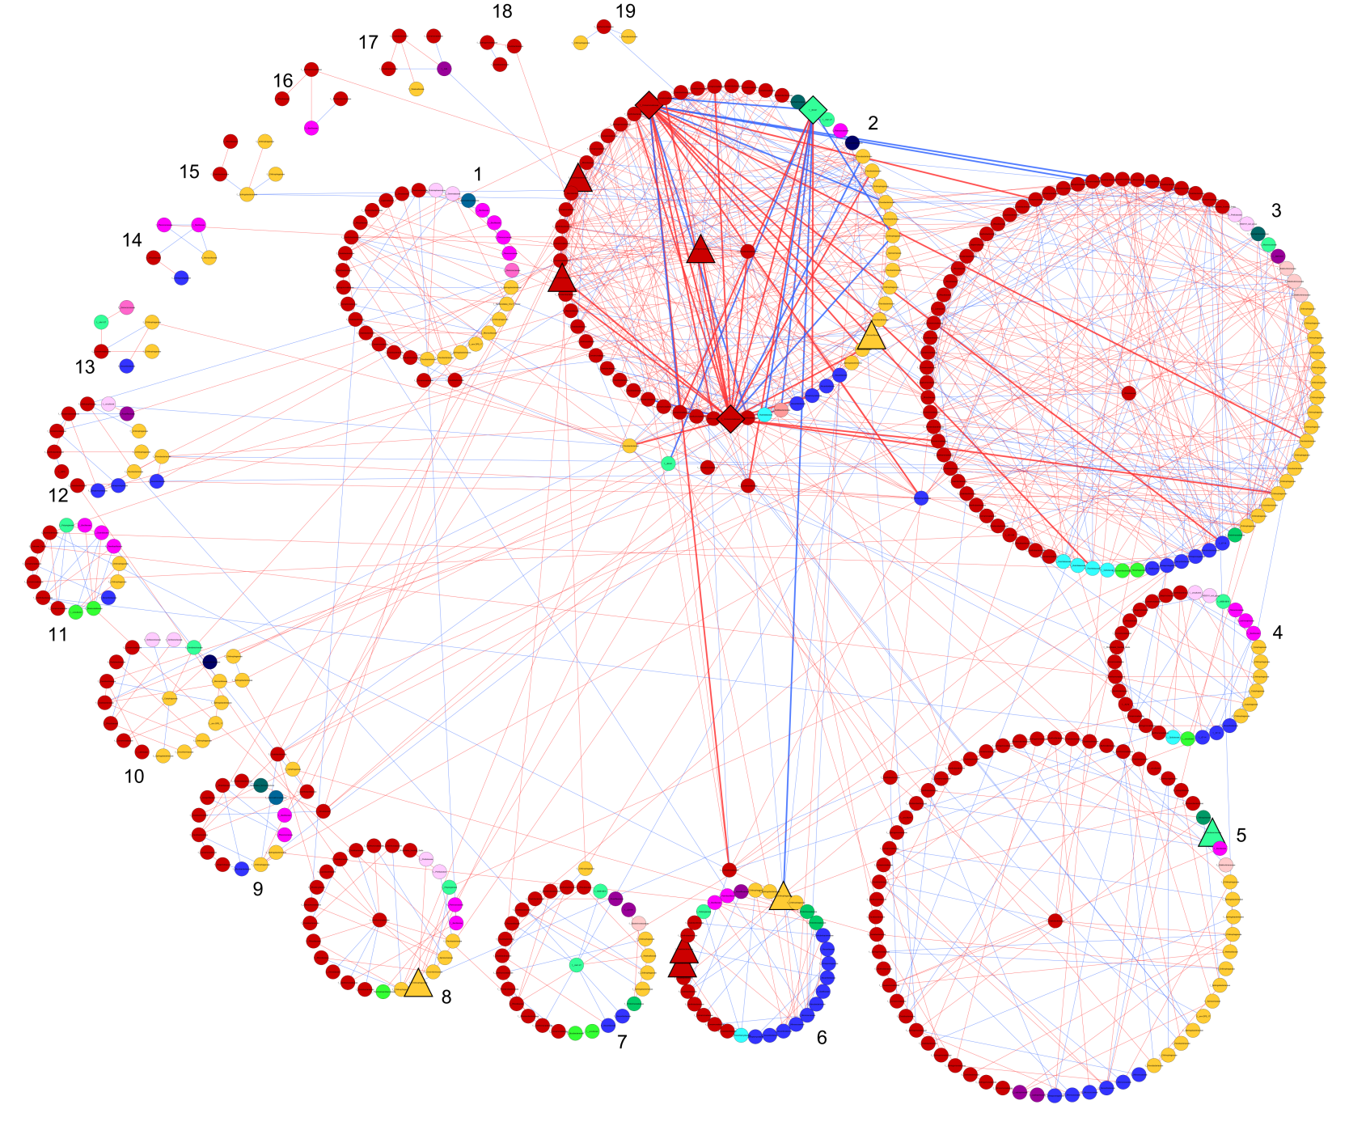
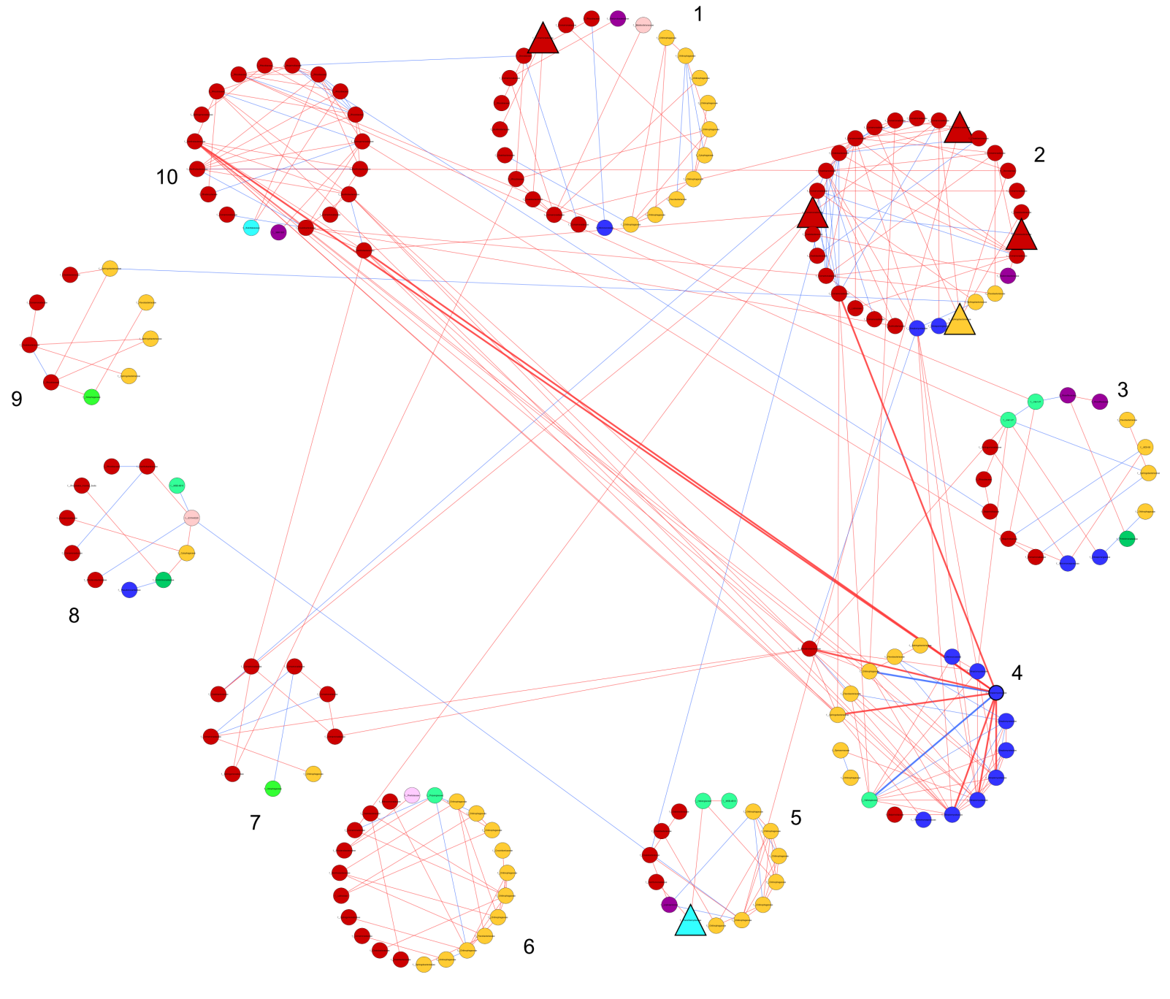
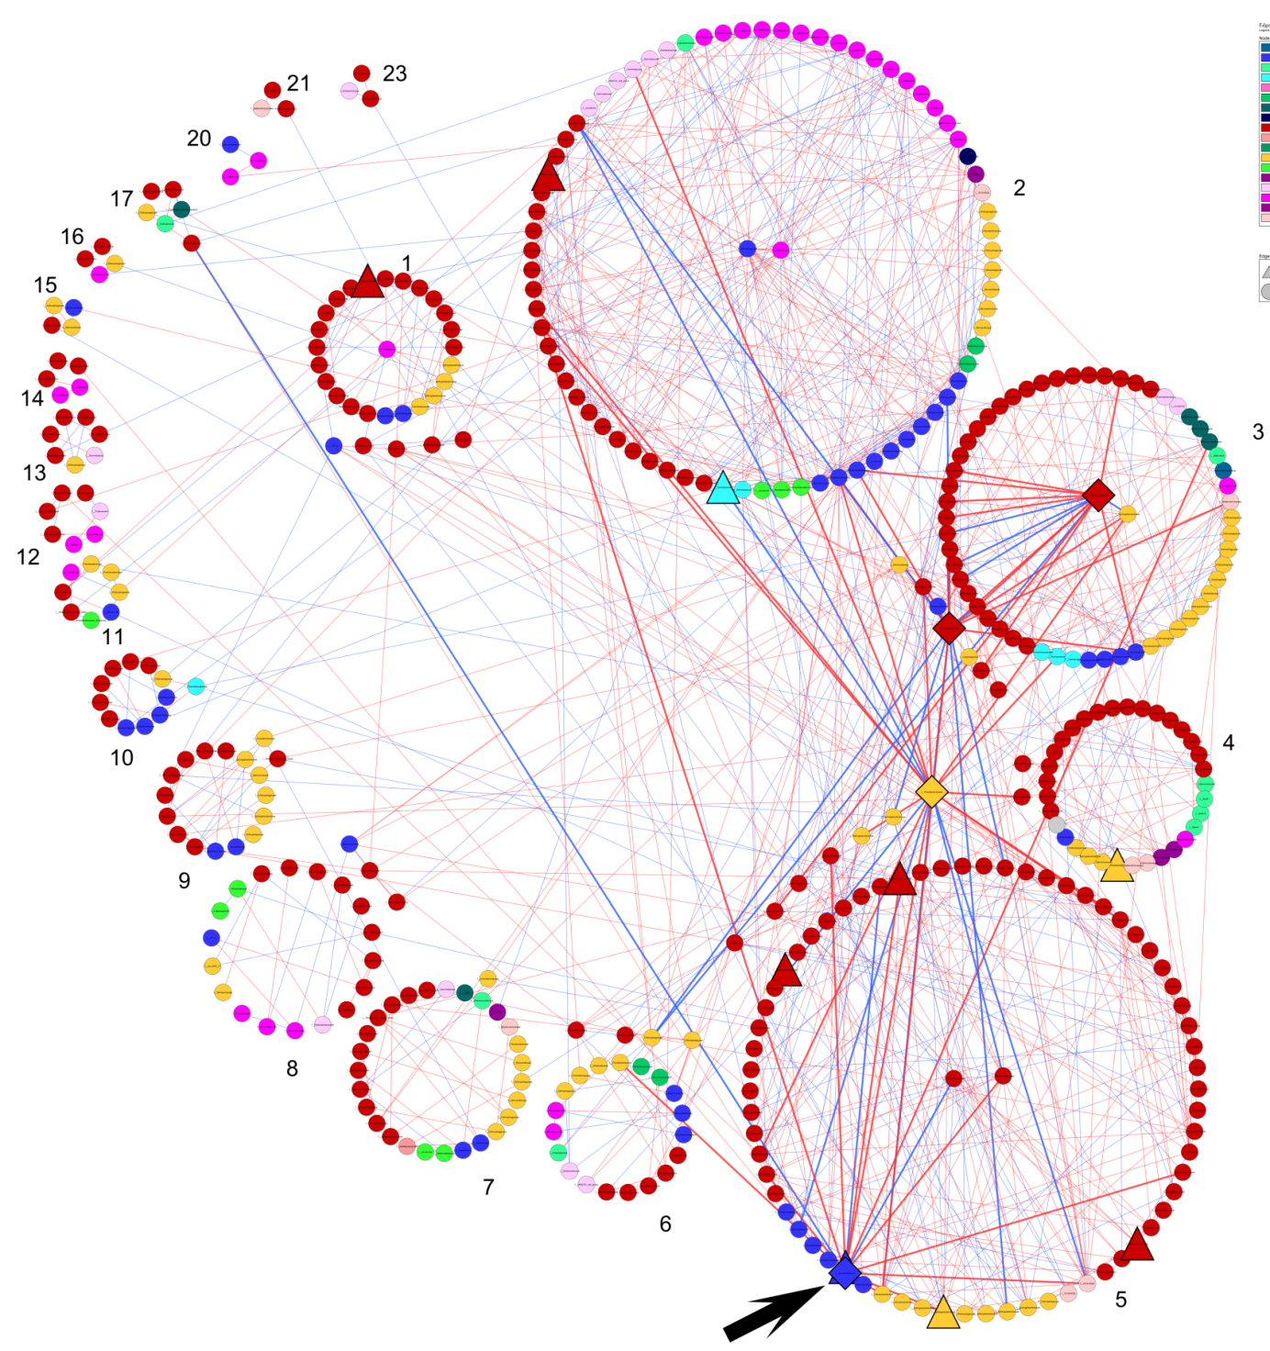
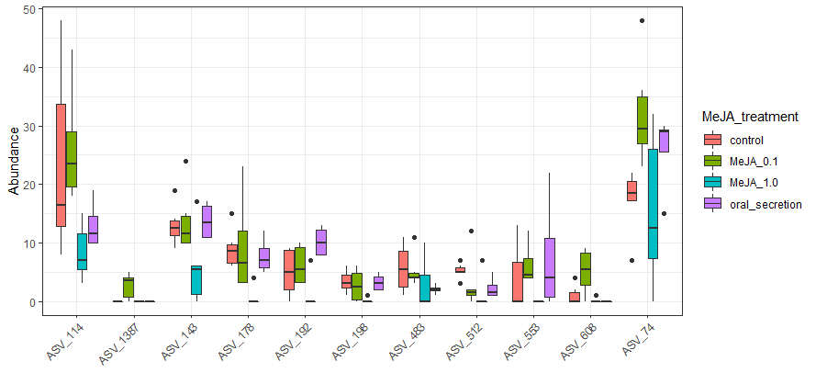
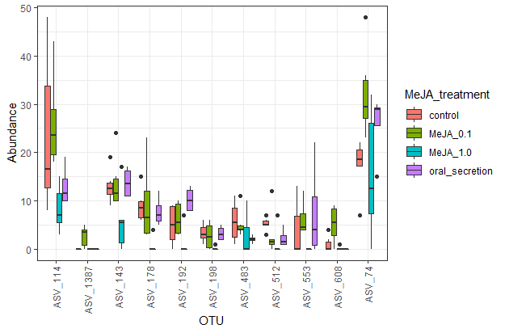
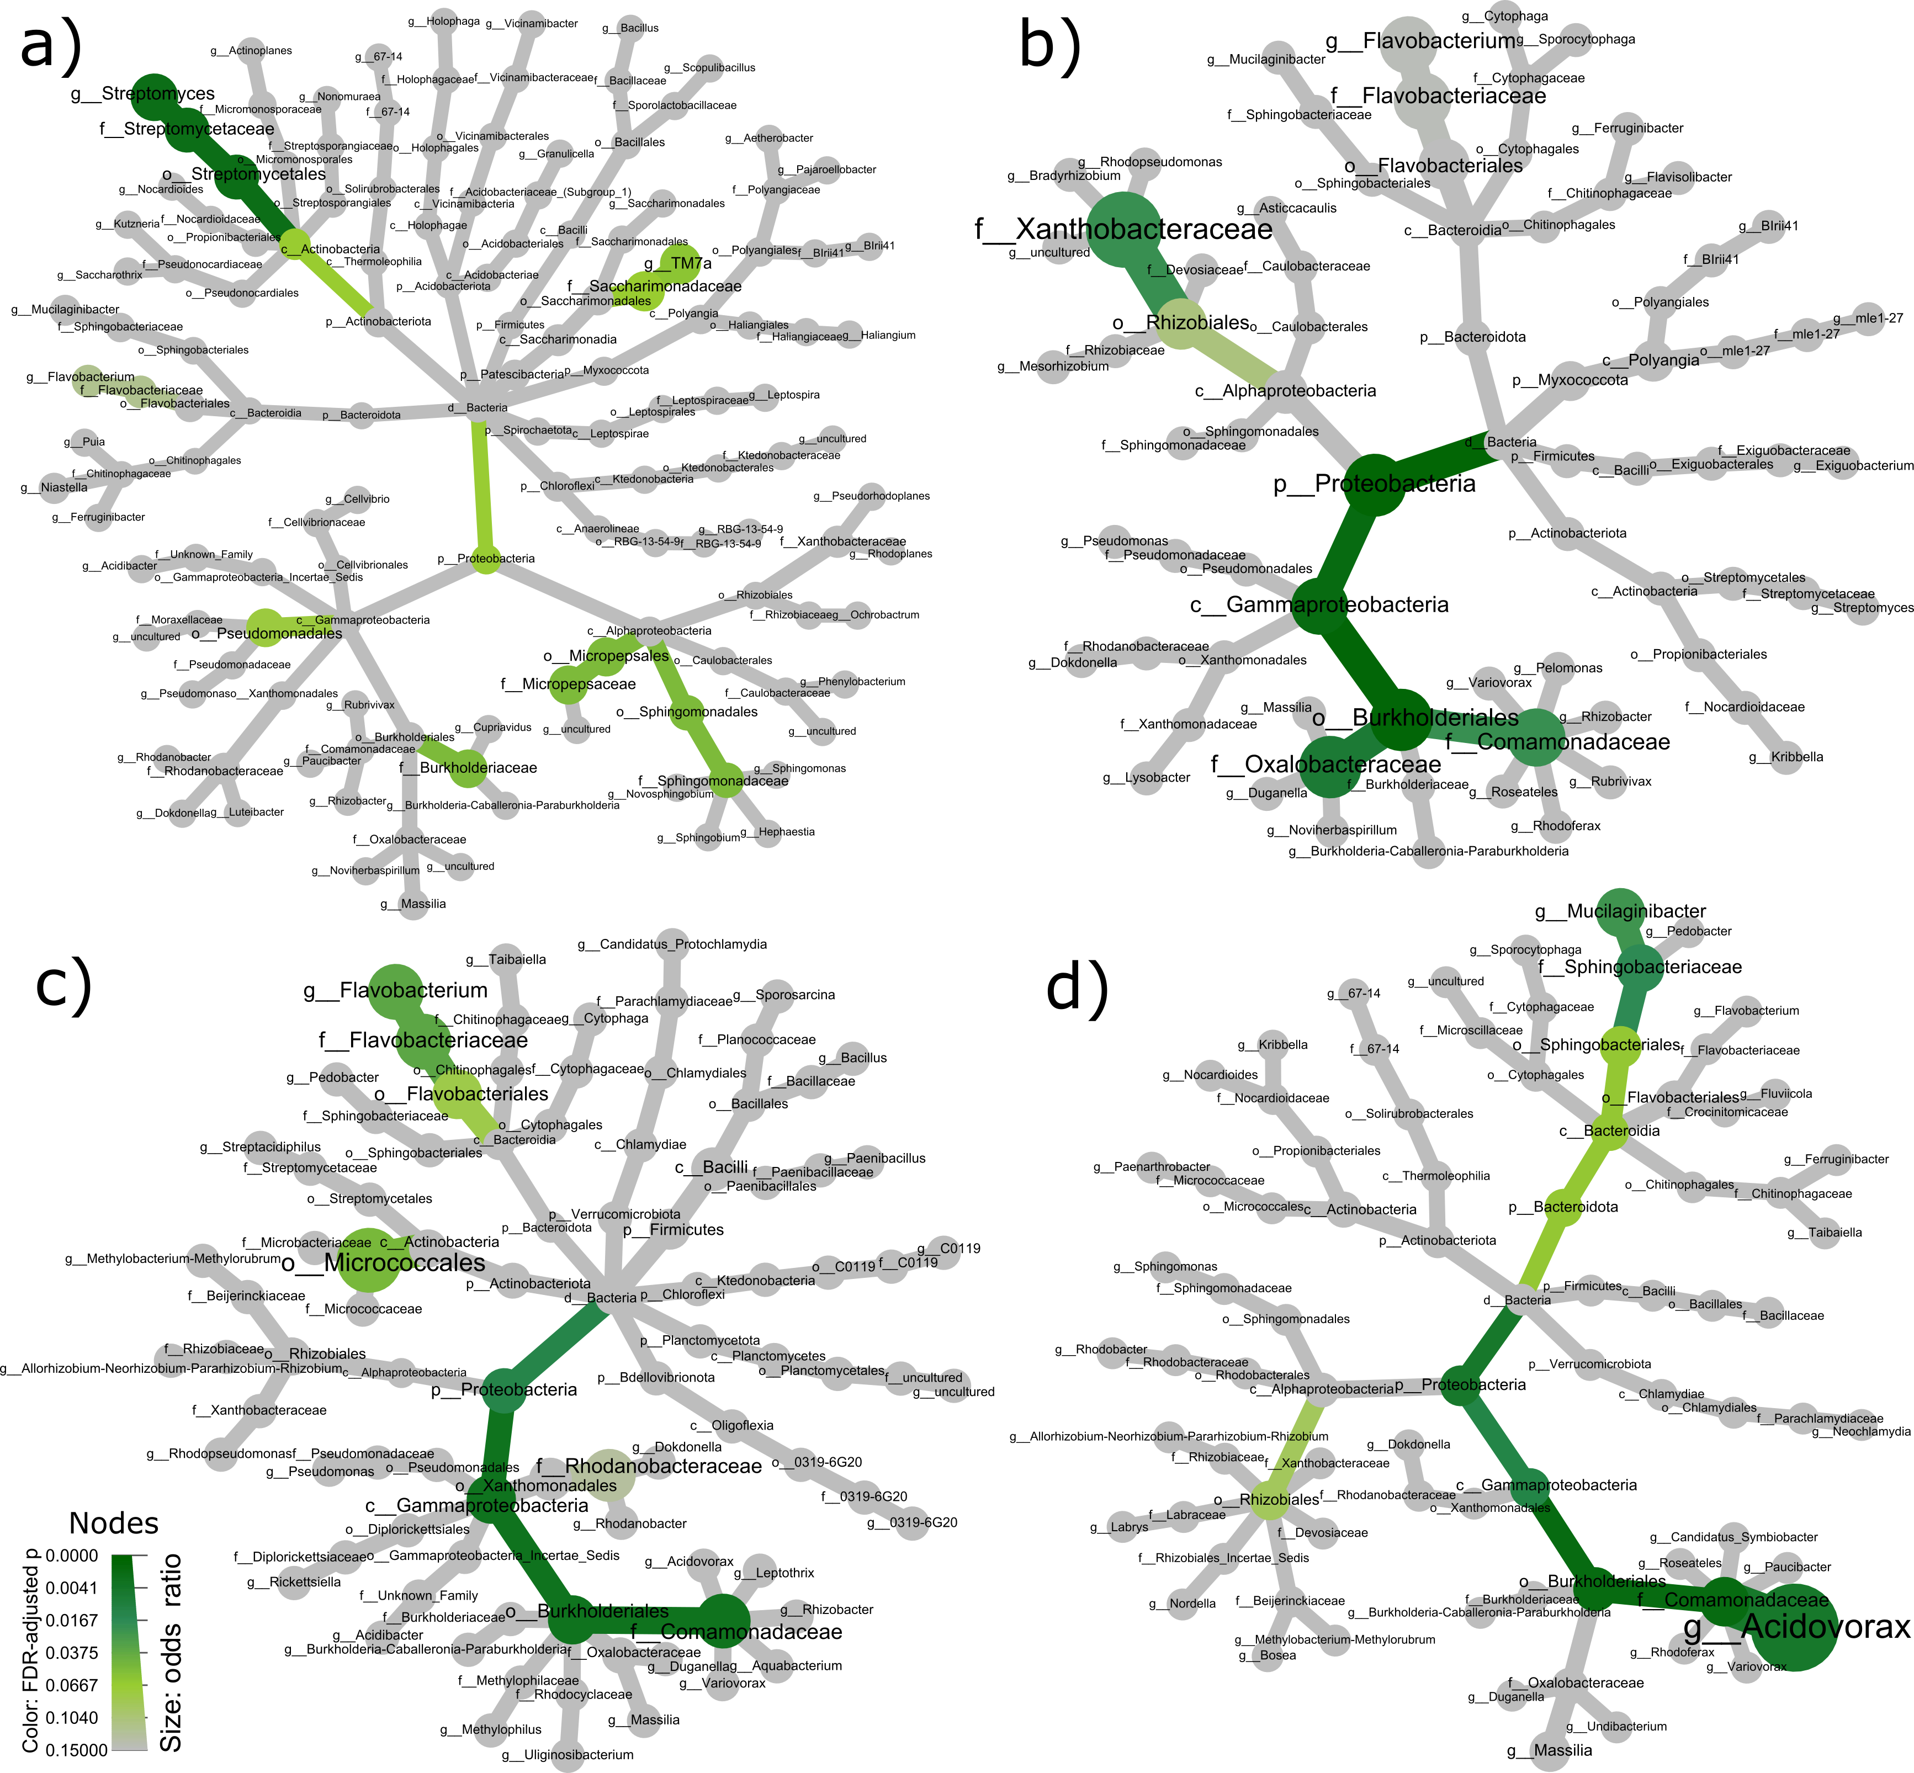
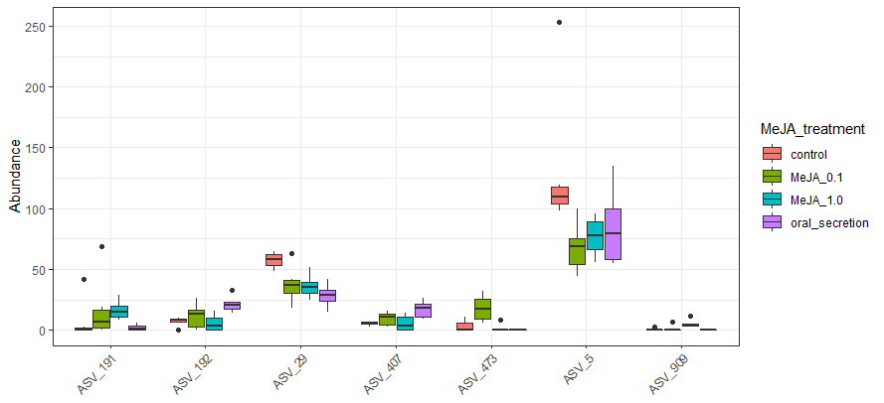
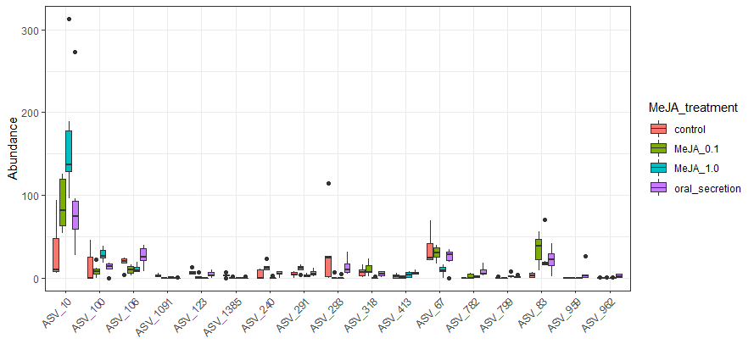
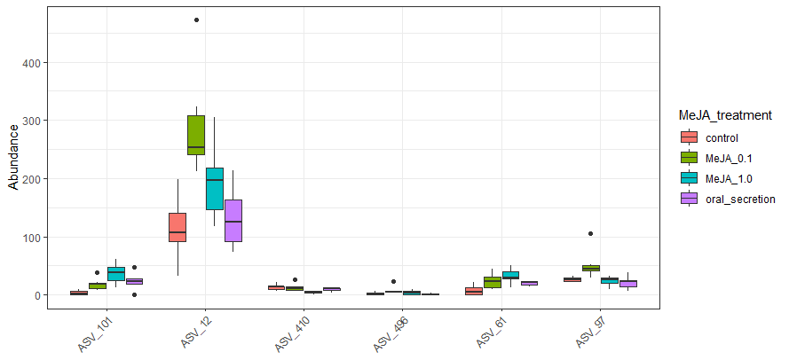
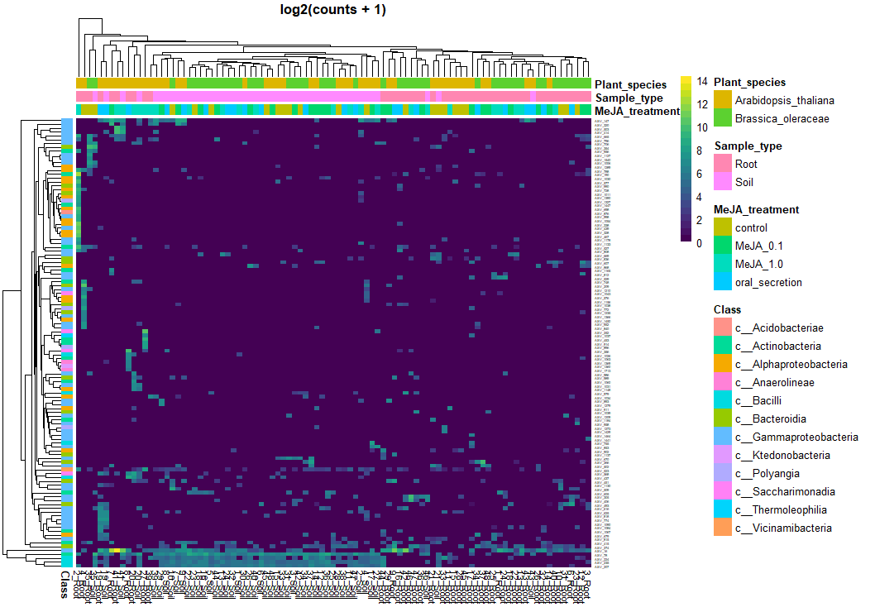
Brassicaceae microbiome response to insect herbivory: summarizing random forest, network analysis, and differential abundance
Pedro Beschoren da Costa¹, Marcela Aragón Gómez ¹, Zulema Carracedo Lorenzo¹, Karen Kloth¹, Erik Poelman¹, Marcel Dicke¹
Wageningen University and Research - Entomology Department, Wageningen, Netherlands
Introduction
Plant-microbe-insect interactions are very complex, but can still be exploited for sustainable agriculture. Data from microbial community sequencing is also complex, despite the numerous analytical tools available. While access to machine learning or network construction algorithms to analyze such data is not a limiting factor, finding a comprehensive pattern in the analysis output can still be very challenging. Here we apply different analytical methods to microbial communities of Brassicaceae plants under herbivory stress, and then summarize the multi-method outputs into a single figure.
Material and methods
We exposed Aradopsis thaliana and Brassica oleraceae to Methyl Jasmonate, a mimic of herbivory stress (Figure 1). We then performed 16S sequencing of plants roots and rhizospheric soil (figure 2). The microbiome dataset was partitioned and processed in R with Boruta for random forest, SPIEC-EASY for network analysis, and Deseq2 for differential abundance. This generated a list of 346 ASVs that were “tagged” as “important” by these different methods. A Fisher test was then used to compare the proportions of every taxonomic group in this list against the proportions of the same taxonomic group in the rest of the dataset. The output from the Fisher tests is summarized in a heat tree.
Results
(a)
Figure 2: NMDS ordination of microbial communities. Data was normalized with Cumulative Sum Scaling. There was a very clear effect of plant species and sample type (Endosphere or rhizosphere) but treatment effects were subtle. We proceed the analysis by partitioning the data in 4 sets, so that plant species and sample type effects do not mask treatment effects.
(b)
Figure 1: Scheme of the experimental design (a); representation of the MeJA dipping process (b).
a)
b)
c)
d)
Random Forest Importance
Figure 3: Co-variance networks of A. thaliana endophytic (a) and rhizospheric (b) communities; B. oleraceae endophytic (c) and rhizospheric (d) communities. Groups of nodes represent modules. Red edges represent positive co-variance, and blue edges represent negative co-variance. Nodes in the center of modules are module hubs (Zi >2.5), nodes outside modules are module connectors (pi>0.62). Keystone taxa (significantly high z-transformed degree, betweenness centrality, and closeness centrality) have thicker edges. Triangles represent ASVs important in random forest, diamonds represent keystone taxa.
AT Endo (n=22) 11 of 2690 ASVs |  | Reference
 |  | Control | MeJA 0.1 | MeJA 1.0 | Oral
Prediction | Control | 22 | 5.1 | 2.8 | 5.3
 | MeJA 0.1 | 0.3 | 21.3 | 0 | 0
 | MeJA 1.0 | 0 | 0.8 | 24.5 | 0
 | Oral | 4.8 | 0.1 | 0 | 12.9
 |  | Accuracy: 0.8086 |  | Kappa: 0.7426
AT Rhizo(n=24) 7 of 3124 ASVs |  | Reference
 |  | Control | MeJA 0.1 | MeJA 1.0 | Oral
Prediction | Control | 20.8 | 4.2 | 1.2 | 0.4
 | MeJA 0.1 | 0.3 | 15.1 | 0.6 | 0.7
 | MeJA 1.0 | 3.9 | 3.2 | 21.8 | 0
 | Oral | 0 | 2.5 | 1.4 | 23.9
 |  | Accuracy: 0.8167 |  | Kappa: 0.7609
BO Endo (n=23) 16 of 2421 ASVs |  | Reference
 |  | Control | MeJA 0.1 | MeJA 1.0 | Oral
Prediction | Control | 19 | 0.3 | 0 | 3.3
 | MeJA 0.1 | 0.4 | 25.8 | 0 | 0.1
 | MeJA 1.0 | 0 | 0.0 | 26.1 | 4.3
 | Oral | 2.4 | 0.0 | 0 | 18.4
 |  | Accuracy: 0.8911 |  | Kappa: 0.8533
BO Rhizo(n=24) 6 of 2558 ASVs |  | Reference
 |  | Control | MeJA 0.1 | MeJA 1.0 | Oral
Prediction | Control | 19.5 | 0 | 0 | 5.1
 | MeJA 0.1 | 0.1 | 21.5 | 4 | 1.4
 | MeJA 1.0 | 1.2 | 3.5 | 14 | 5.8
 | Oral | 4.82 | 0 | 7 | 12.7
 |  | Accuracy: 0.6784 |  | Kappa: 0.6714
Figure 4: Random forest output showing the confusion matrix (table to the left) and the abundance of ASVs selected as predictors for stress treatment in each data partition (right). AT = Arabidopsis thaliana, BO = Brassica oleraceae, Endo = endosphere samples, Rhizo = rhizosphere samples.
Figure 5: Biplot heatmap representing differential abundance analysis of ASVs in each treatment against their respective controls. ASVs are represented in rows, samples are represented in columns, cell colors represent log-transformed abundances..
Figure 6: Summary of “important” ASVs. Proportions in the occurrence of ASVs in each taxa level are tested with Fisher test as in Table 1. An ASV is “important” if highlighted by random forest, network analysis, or differential abundance. Node colors indicate adjusted p values, node size indicates odds ratio with a maximum of: 12.9 in A. thaliana endosphere (a), 5.8 in A. thaliana rhizosphere (b); 6.1 in B. oleraceae endosphere (c); and 21.3 in B. oleraceae rhizosphere (d) .
Conclusions
​B.oleraceae soil | Important ​ASV ​​ | Other ASV | Total (R)​
Mucilaginibacter ASV​ | 5​ | 57​ | 62​
ASV in other genus​ | 48​ | 2442​ | 2490​
Total (C)​ | 53​ | 2499​ | 2557​
Table 1: Example of proportions compared in fisher tests (Mucilaginibacter in rhizosphere of B. oleraceae), used to define node color and size in figure 6.
The summarization allows us to, in a glance, detect which microbial taxa are significantly more represented as “important”, having the full microbial community as a context. Noticeably, Family Comamonadaceae is summarized as significantly more represented in 3 our of 4 data partitions. This diverse family is not only common in plant endosphere and rhizosphere, but is also common in the gut of herbivorous insects and other organisms that survive on poor diets. It is possible that members of this family use both plant and herbivore as alternative hosts to increase its niche breath and dispersal, similarly to Enterobacteriaceae that also thrive in both plant roots and mammal gut. While this analysis cannot tell if Comamonadaceae are beneficial or detrimental to the plant, it allows us to focus our attention for literature mining, further analysis, and new experiments in 1 out of the 1.111 taxonomic groups detected by 16S amplicon sequencing.

